Slide 1
VIPASSANĀ MANAGEMENT SYSTEM
Daniela Koch
Matej Michalek
Michaela Golhova
Michal Karol Pompa
Remedios Pastor Molines

Slide 2
Agenda
Introduction
Analysis
Design
Implementation
Process
Conclusion

Slide 3



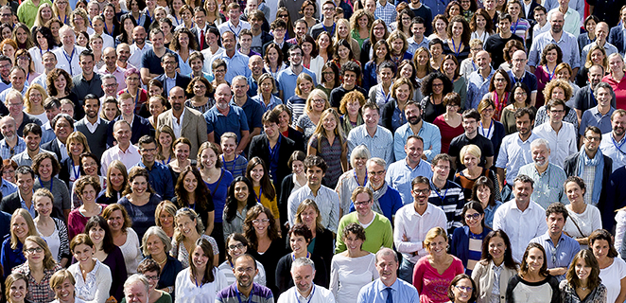
Introduction

Slide 4



Introduction
US
VIA

Slide 5


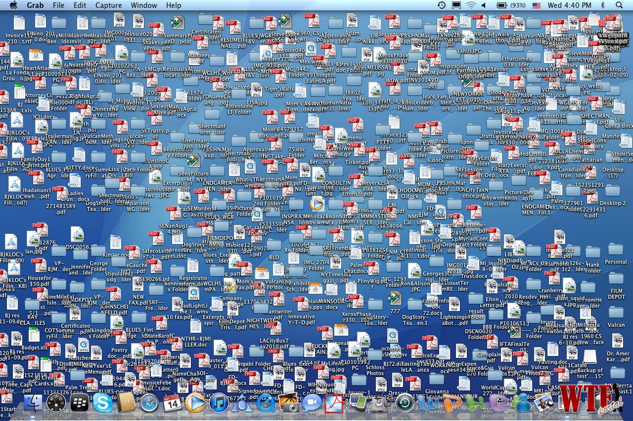


Slide 6


Slide 7

Problem statement
How to store data about events, members and lecturers?

Slide 8

Problem statement
How to find proper lecturers for events ?

Slide 9

Problem statement
How to make the system easy to extend and provide new functionalities?

Slide 10






Delimitations
FEEDBACK

Slide 11


Slide 12




Functional requirements
Members/Participants
Lecturer
Event
Newsletter

Slide 13
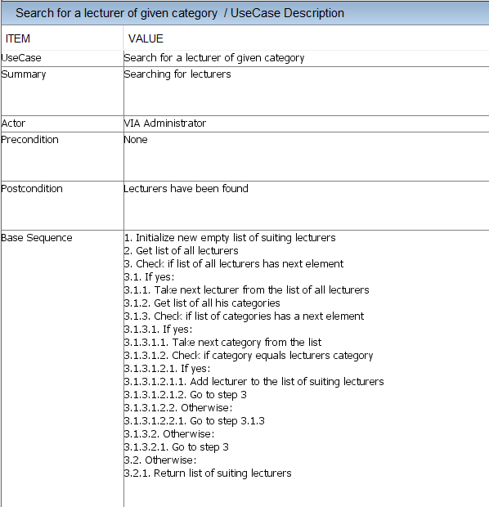

Slide 14
Functional requirements
Members/Participants
Lecturer
Event
Newsletter

Slide 15



Non-functional requirements
The system must be implemented in Java
Secondary storage needs to be done with files (Event/Lecturer/Memberlists, newsletter)
The parts of the system must be accessible among them

Slide 16
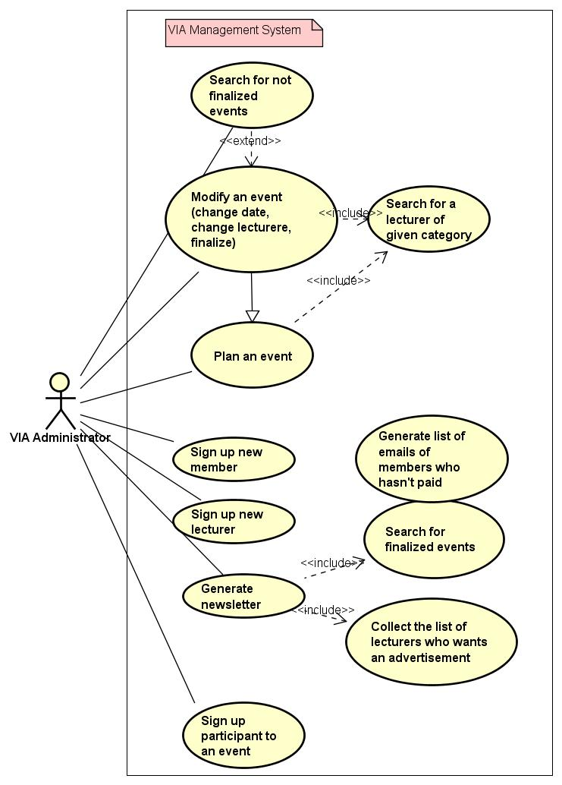
USE CASE DIAGRAM

Slide 17
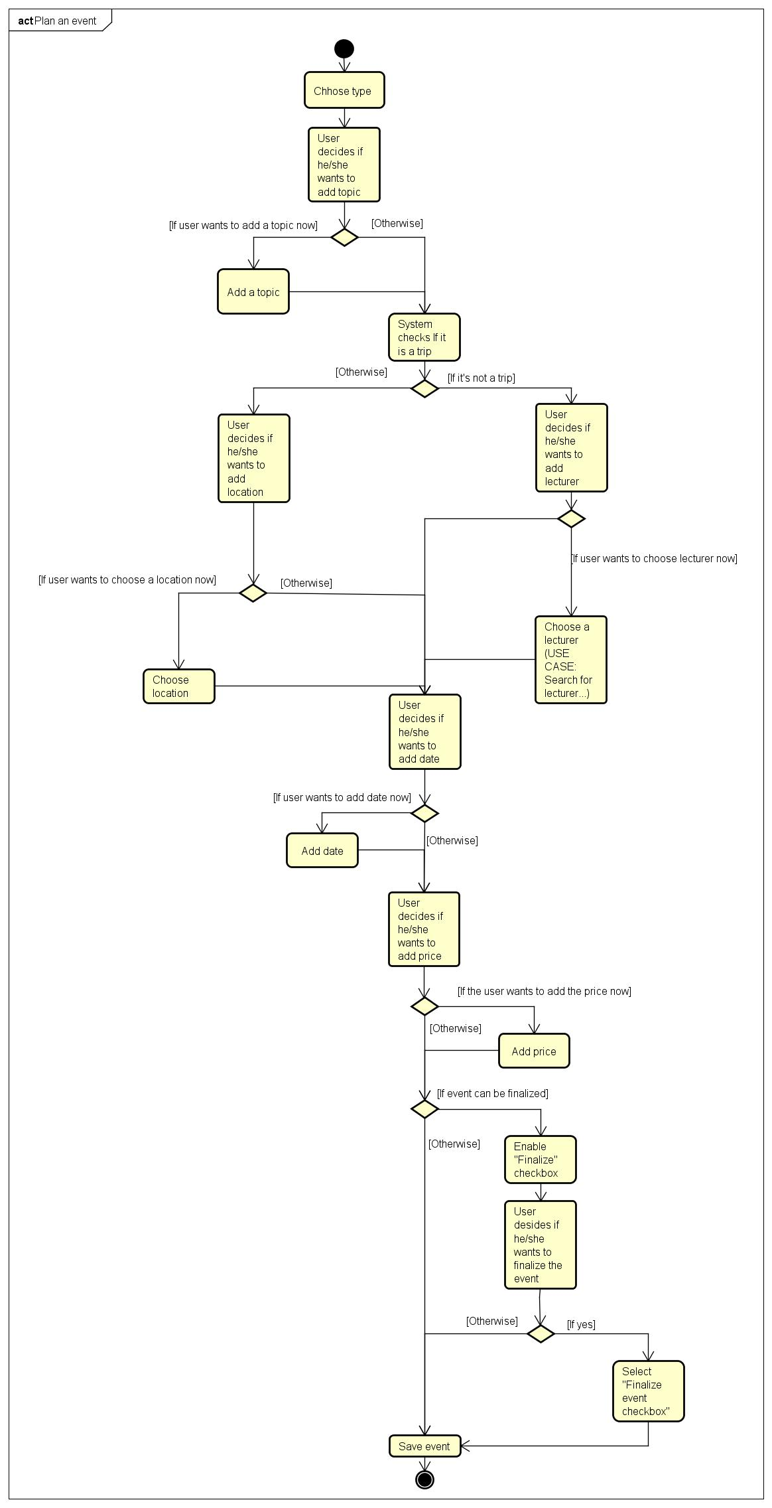
ACTIVITY DIAGRAM Create event

Slide 19
Design

Slide 20
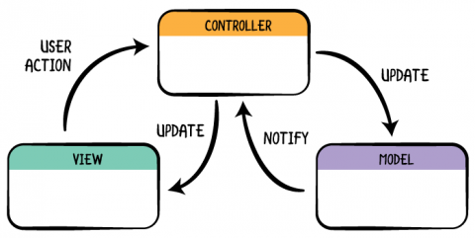
Model-view-controller

Slide 21
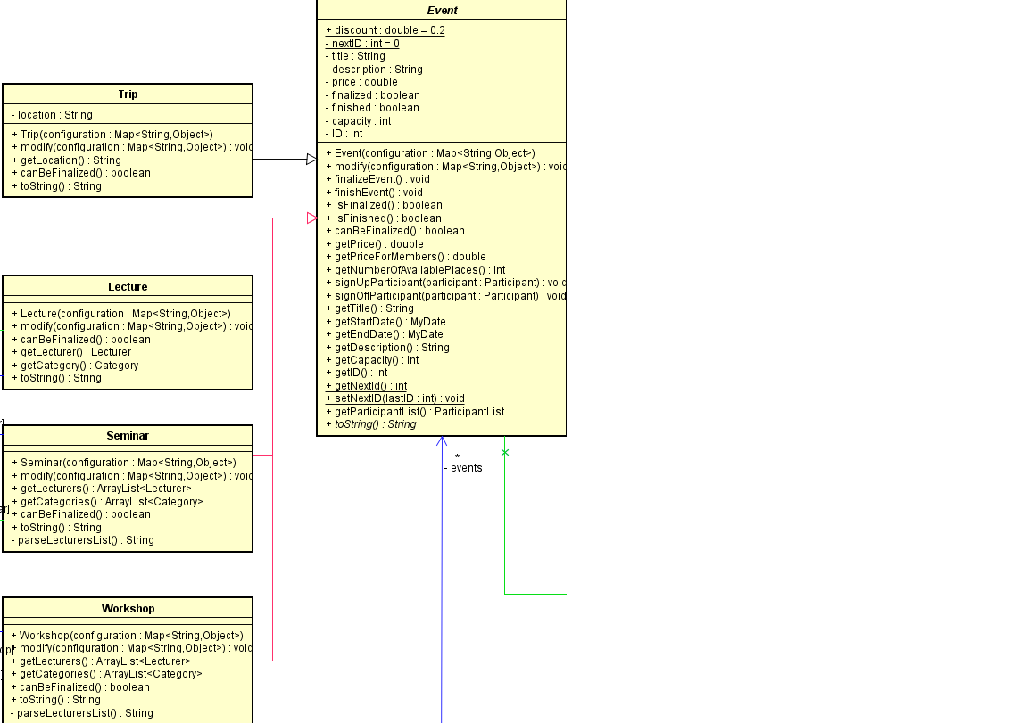
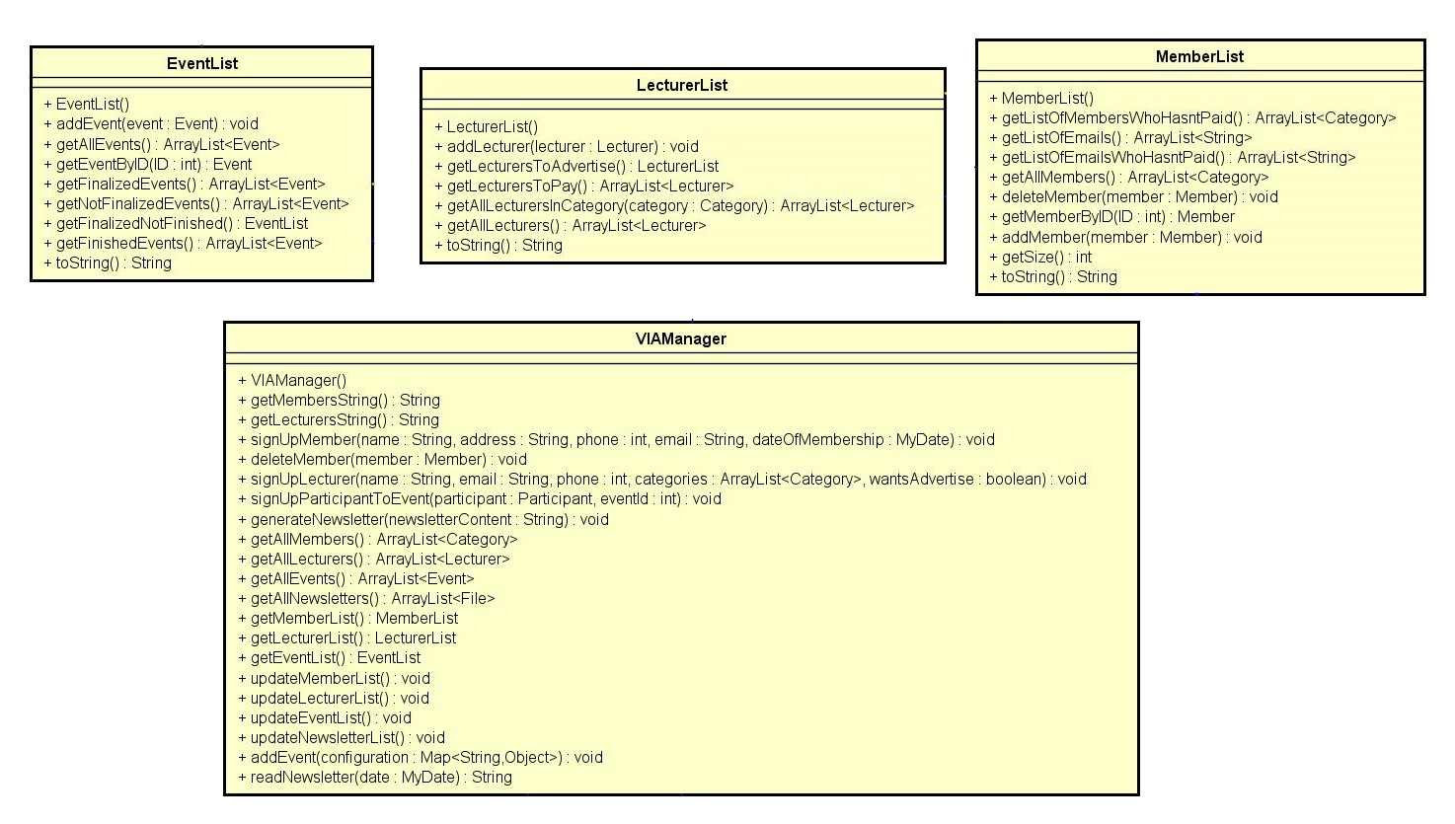
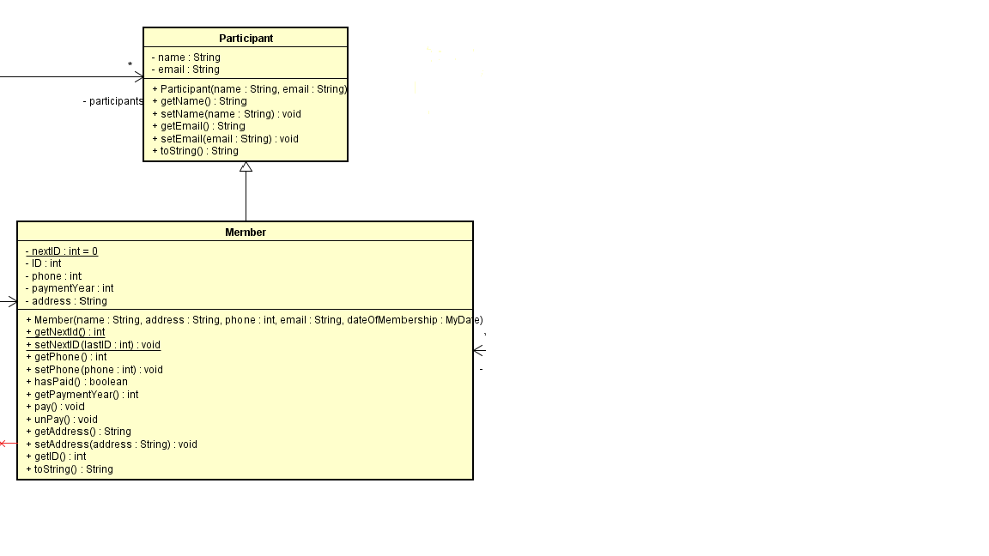
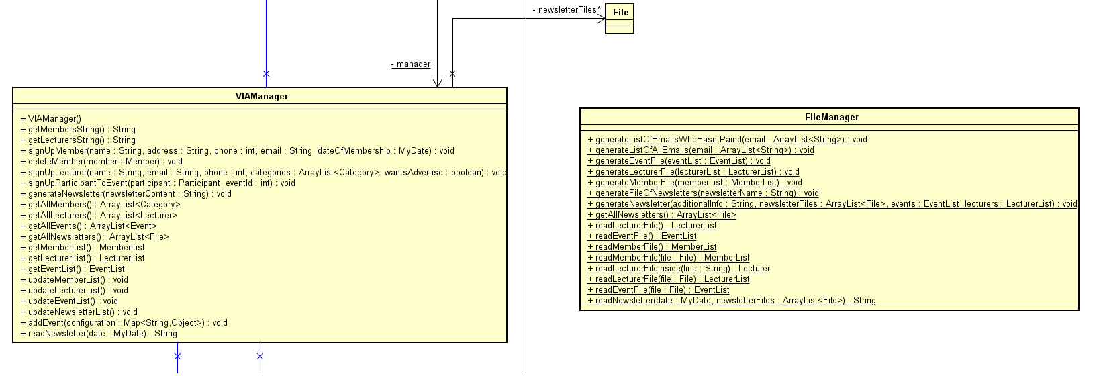
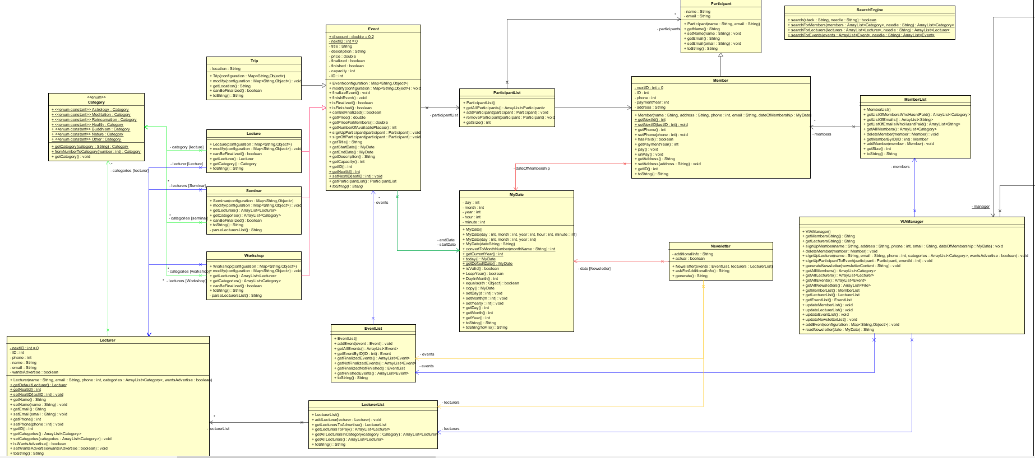
Model

Slide 22
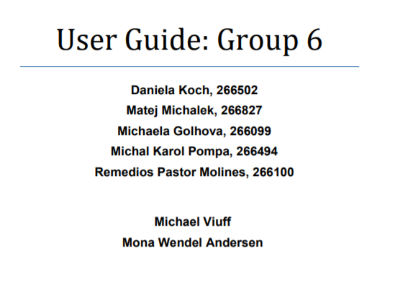
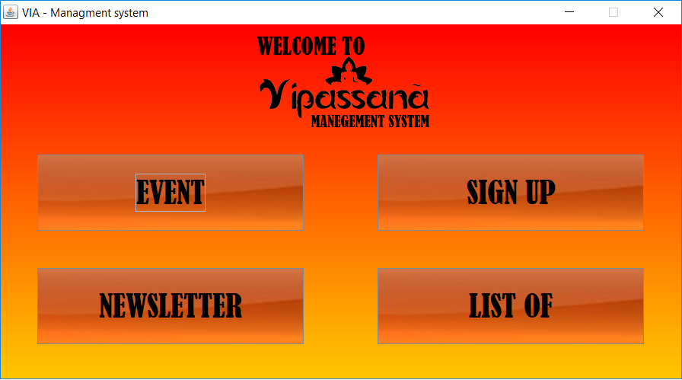
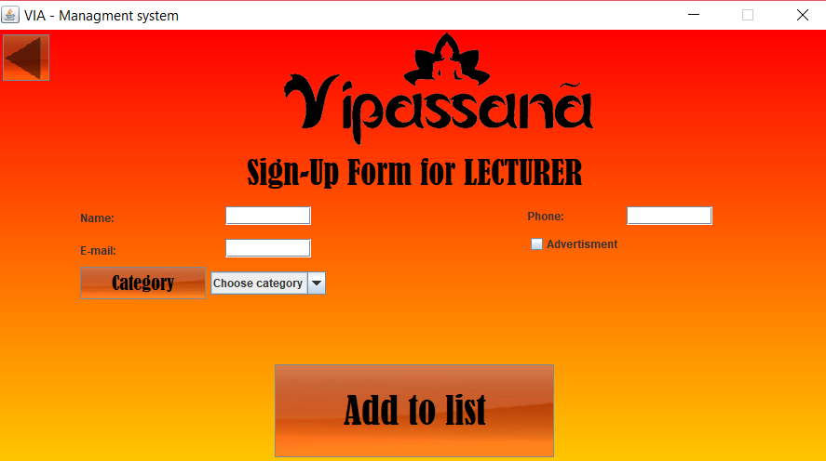
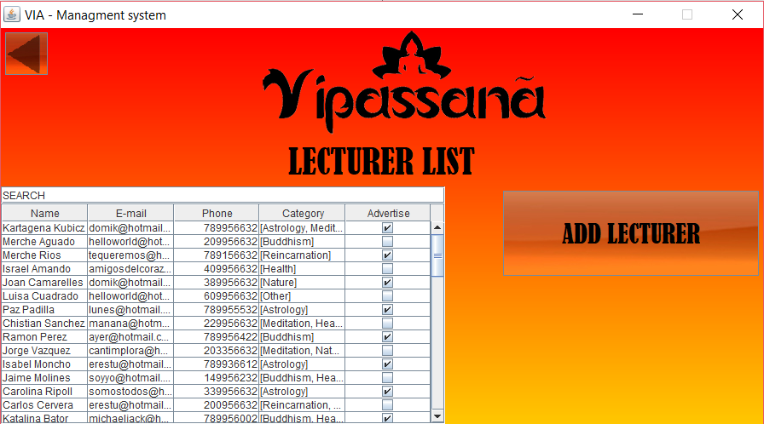
View

Slide 23
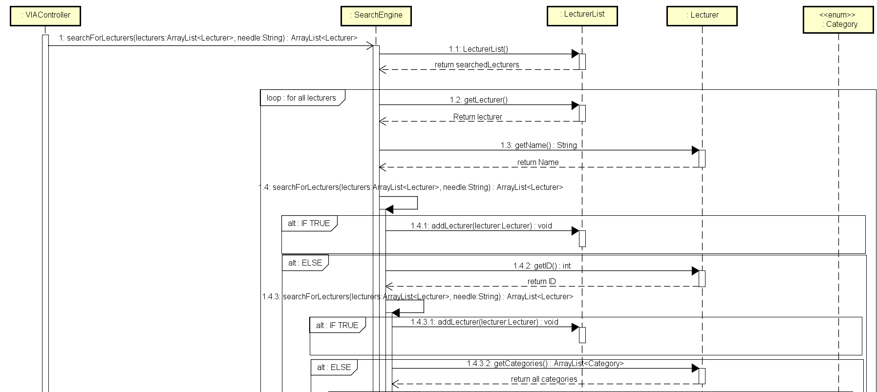
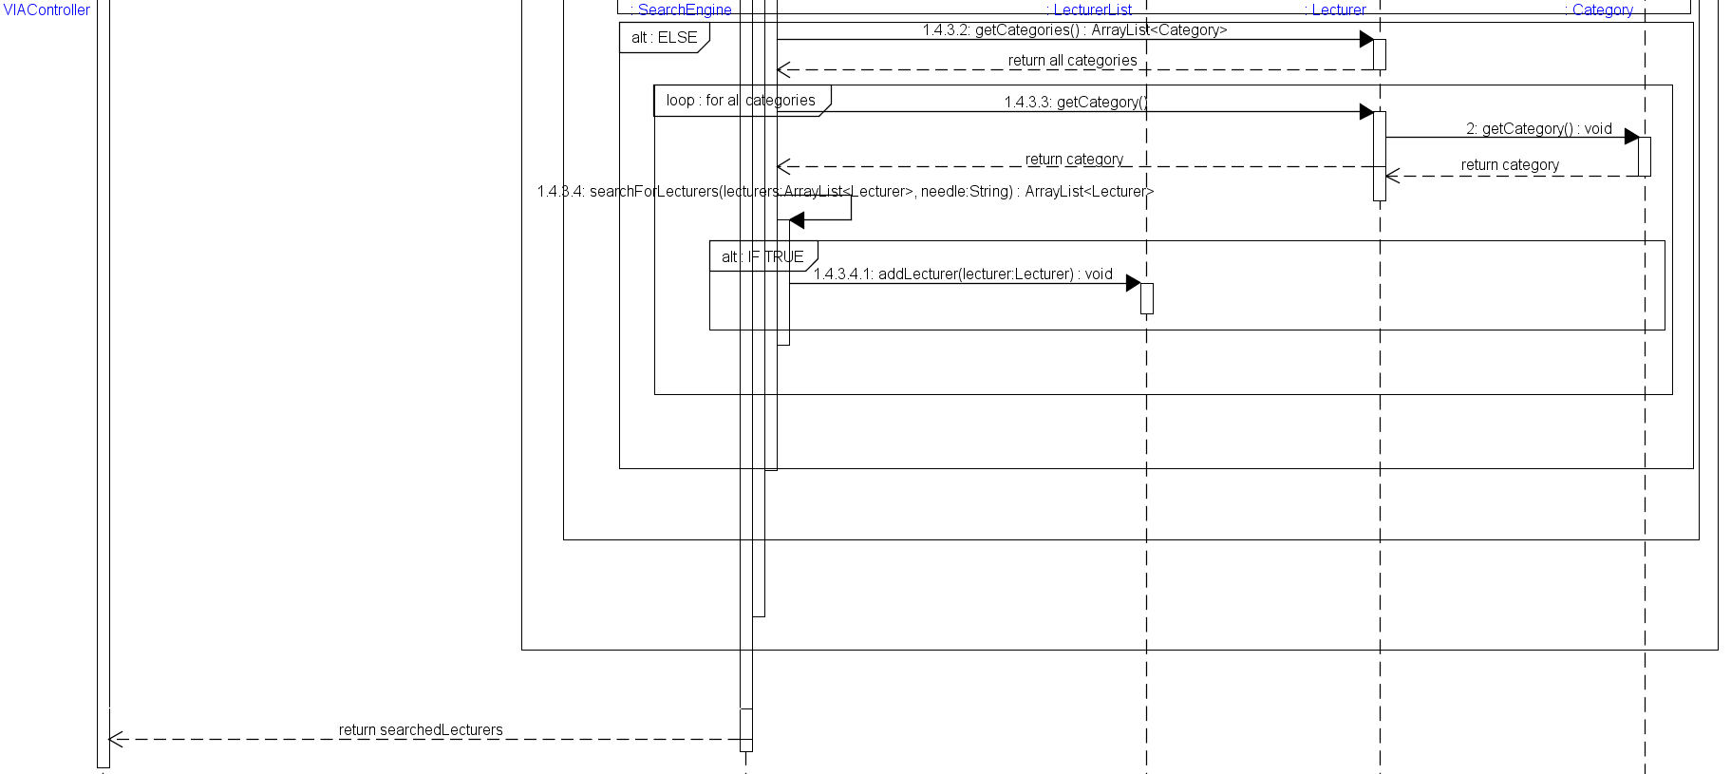
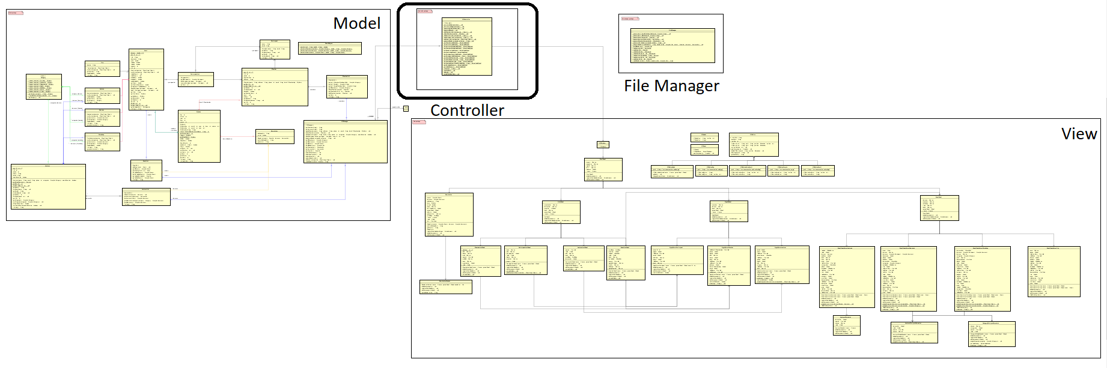
Controller

Slide 24
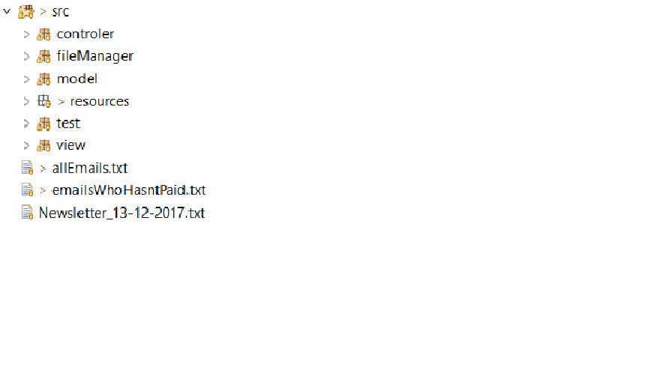

Organizing the code

Slide 25
Implementation

Slide 26
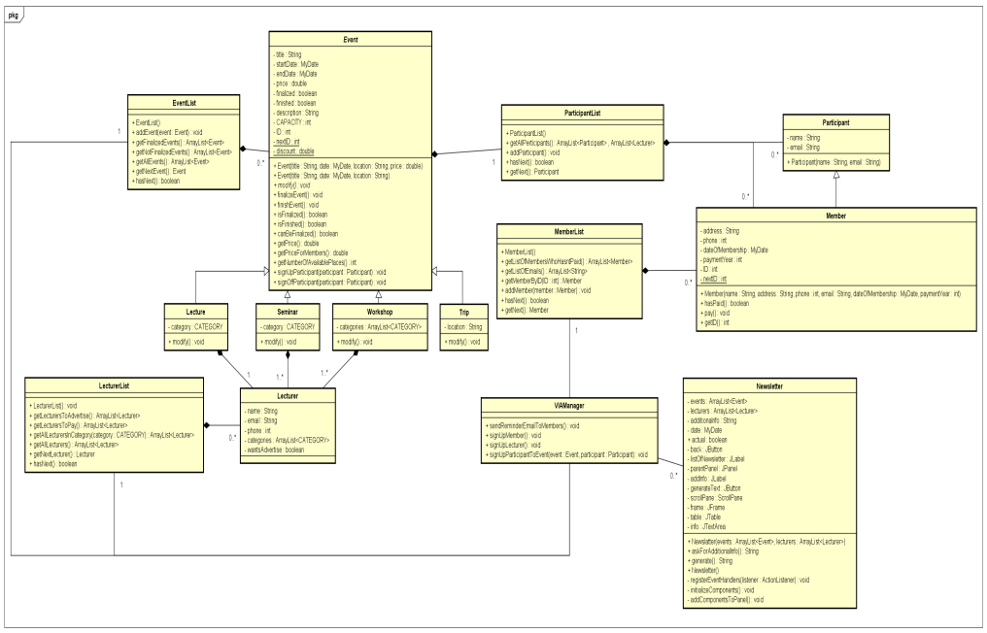
Work Methodology
GUI
MODEL

Slide 27
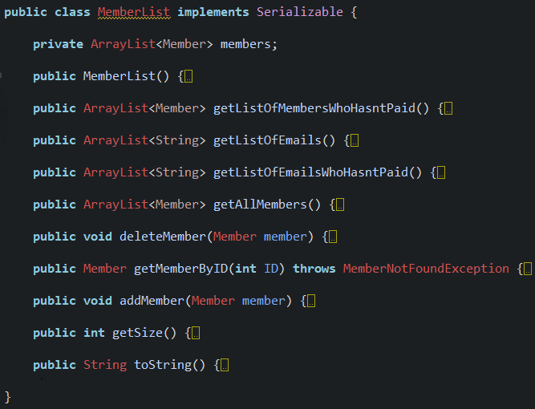
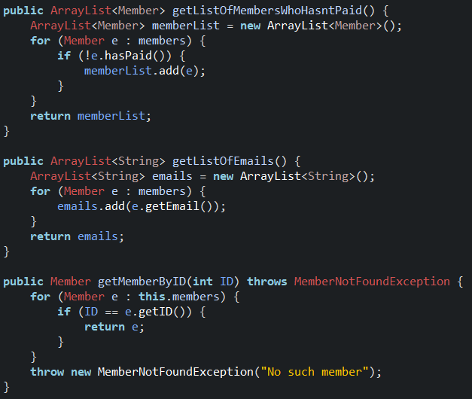
Class example – Member List

Slide 28
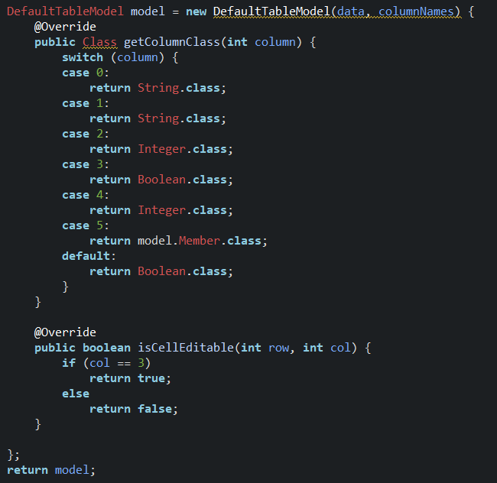
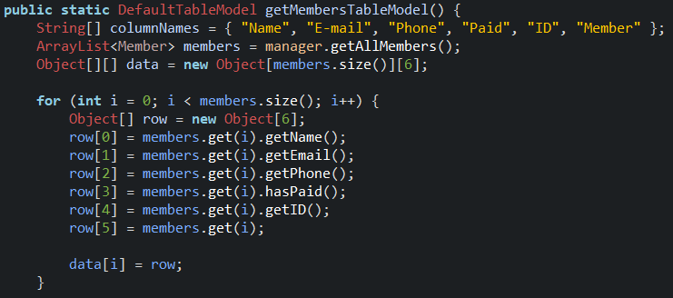
Controller - DefaultTableModel

Slide 29
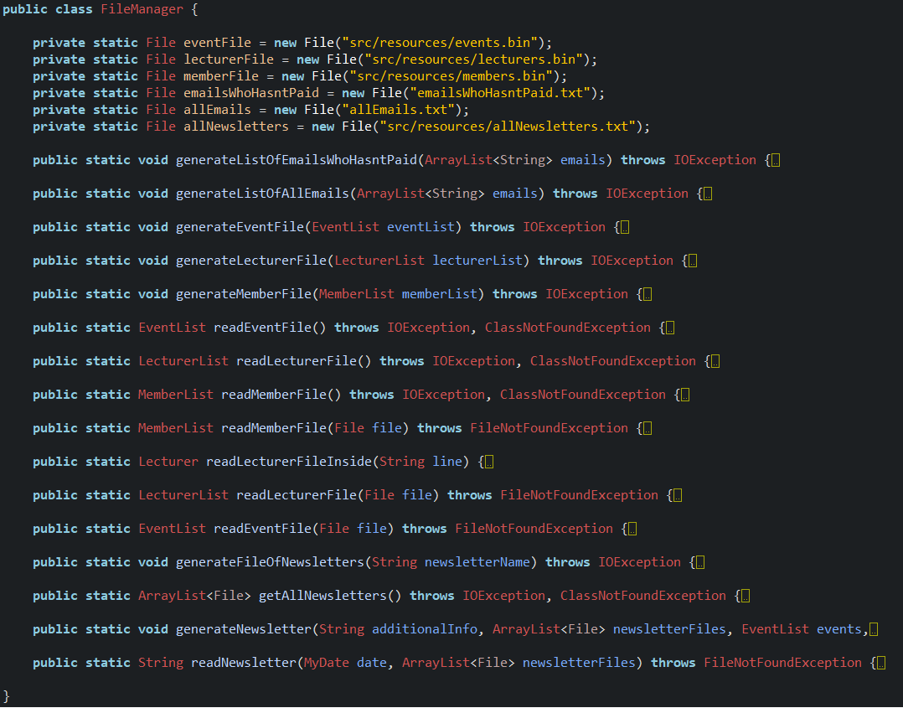
FileManager

Slide 30
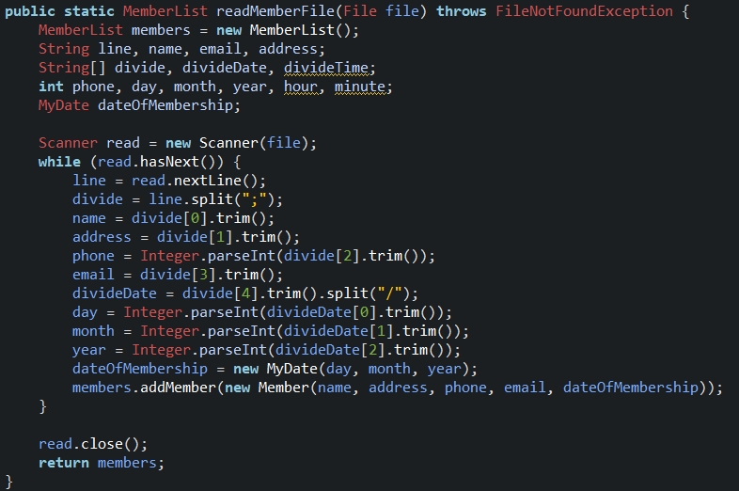
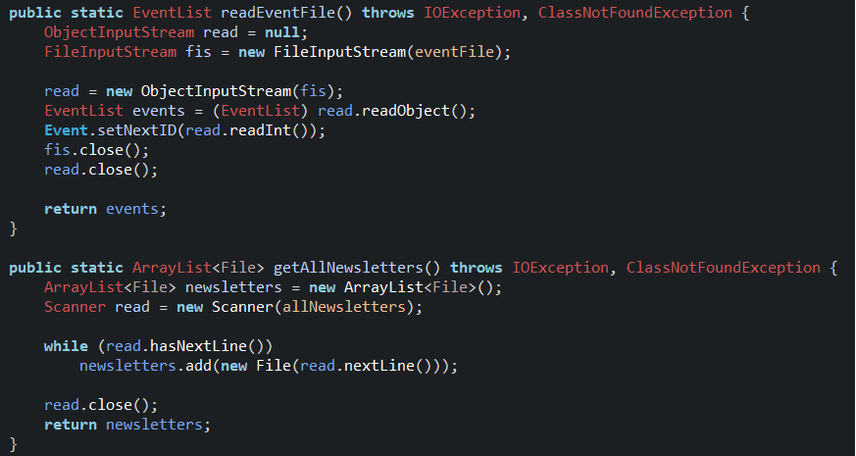
FileManager

Slide 31
Testing

Slide 32
Belbin roles, work methods, motivation

Slide 33
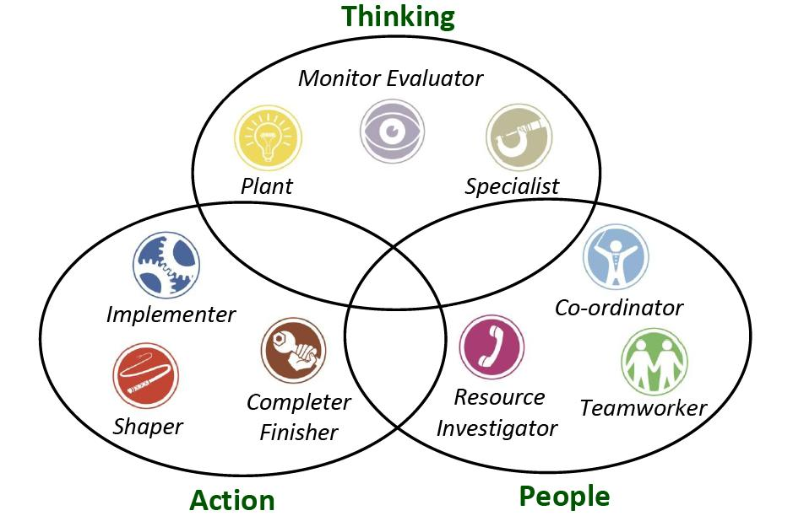

Slide 34
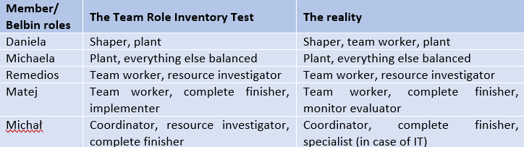
Belbin roles

Slide 35
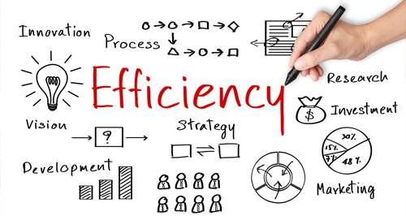
Work Methods
Gather ideas and formulate the main goals and overall structure together
Divide the work for groups consisting of 1-3 persons
Having everything checked by everyone

Slide 36



Using technical tools to help us working in group

Slide 37


Slide 38

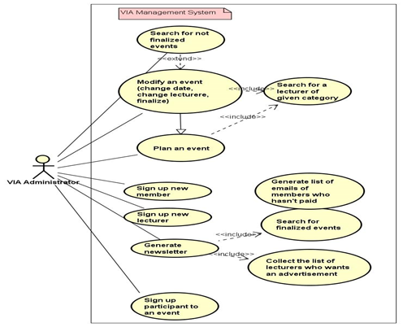
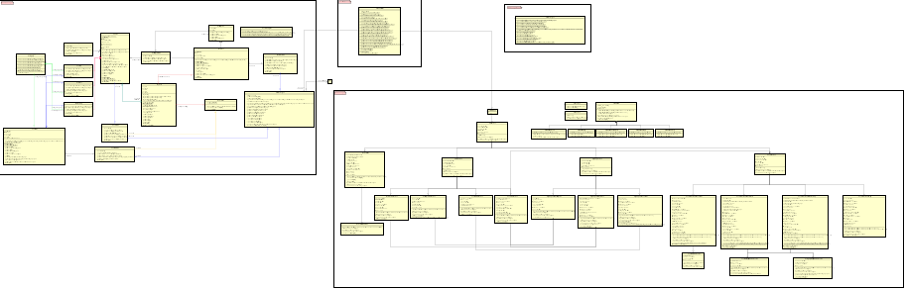
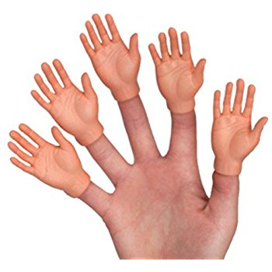
Conclusion (project report)

Slide 39







Conclusion (process report)

Slide 40
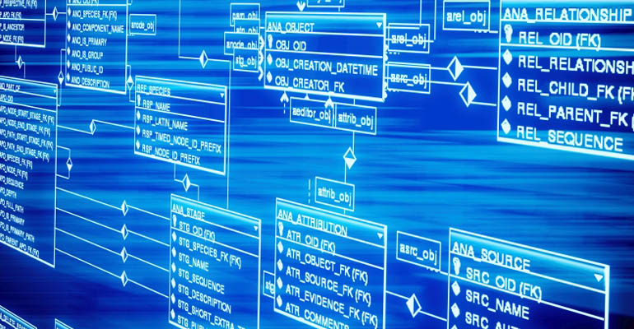


Future

